Slide 1
Using inequality notation for errors in calculations
Estimation and rounding

Slide 2
how to use Oak lessons

Slide 3
I can use inequality notation a ≤ x < b to express errors in calculations.

Slide 4
An error interval for a number x shows the range of possible values of x.
It is written as an inequality a ≤ x < b

Slide 5

Using inequality notation for errors in calculations
Error intervals (addition and multiplication)
Error intervals in calculations

Slide 6
Error intervals (addition and multiplication)
When a number has been rounded to a degree of accuracy, we are able to identify the range of values the unrounded numbers could be. We represent this using an error interval.
For example, 43 has been rounded to the nearest whole number. What is the error interval?
Drawing a number line, 43 goes in the middle.
As the degree of accuracy is the nearest whole number, we +1 and −1 from 43
Identify the middle values.
From here identify the range of values.
This means the error interval is 42.5 ≤ x < 43.5
42.5
43.5
42
43
44

Slide 7
Error intervals (addition and multiplication)
We use error intervals to help us calculate the largest and smallest values of a calculation.
The error interval has a lower and upper limit.
a ≤ x < b
Where a represents the lower limit of the error interval and b represents the upper limit of the error interval.
However, it is important to know which limits from our error intervals to use in order to calculate the largest and smallest values.

Slide 8

Error intervals (addition and multiplication)
For example, here is a road. Each length has been measured to 2 significant figures.
Identify the error interval of each length
Work out the error interval for the overall distance.
Road x
Road y
32 m
84 m
31.5 ≤ x < 32.5
83.5 ≤ y < 84.5

Slide 9
Error intervals (addition and multiplication)
b) Work out the error interval for the overall distance.
Smallest distance : 31.5 + 83.5 = 115 m
115 ≤ d < 117
Largest distance : 32.5 + 84.5 = 117 m
Road x
Road y
32 m
84 m
31.5 ≤ x < 32.5
83.5 ≤ y < 84.5

Slide 10
Error intervals (addition and multiplication)
b) Work out the error interval for the overall distance.
Smallest distance : 31.5 + 83.5 = 115 m
115 ≤ d < 117
Largest distance : 32.5 + 84.5 = 117 m
Notice how we do not include the 117. This is because we used 32.5 and 84.5 which are not included in the error interval.
31.5 ≤ x < 32.5
83.5 ≤ y < 84.5

Slide 11
Error intervals (addition and multiplication)
b) Work out the error interval for the overall distance.
115 ≤ d < 117
Summarising:
115 is the sum of the lower limits of the error intervals.
117 is the sum of the upper limits of the error intervals.
31.5 ≤ x < 32.5
83.5 ≤ y < 84.5

Slide 12
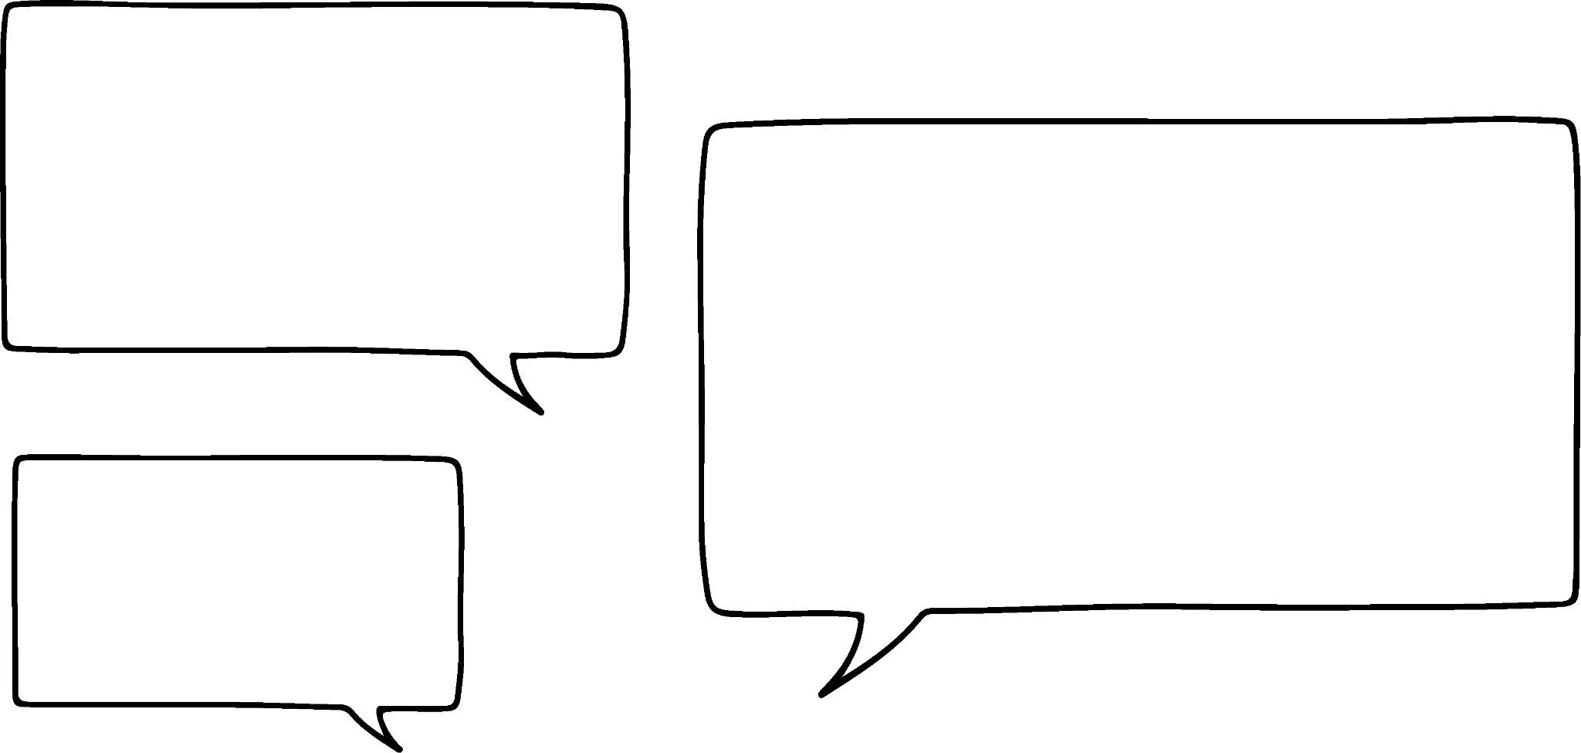
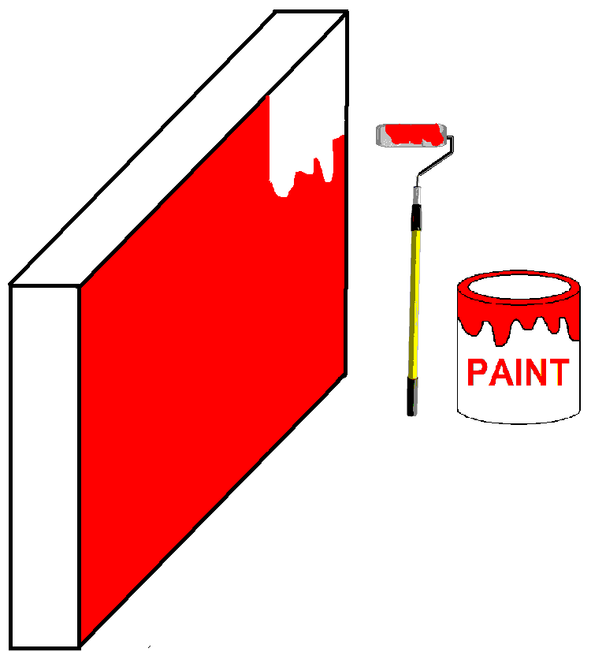
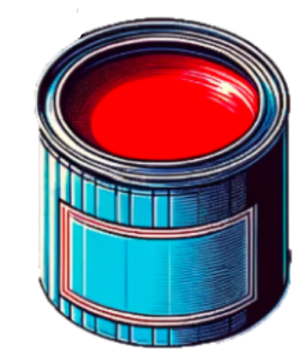
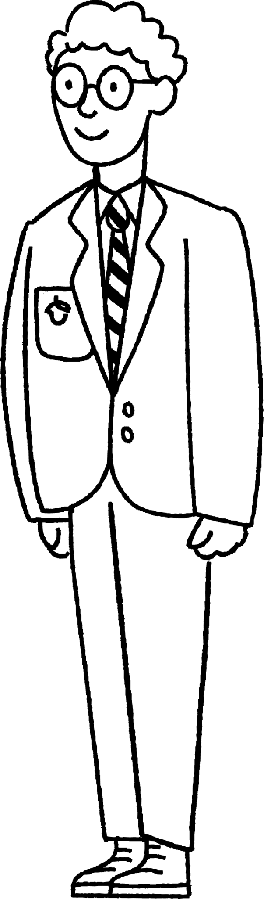
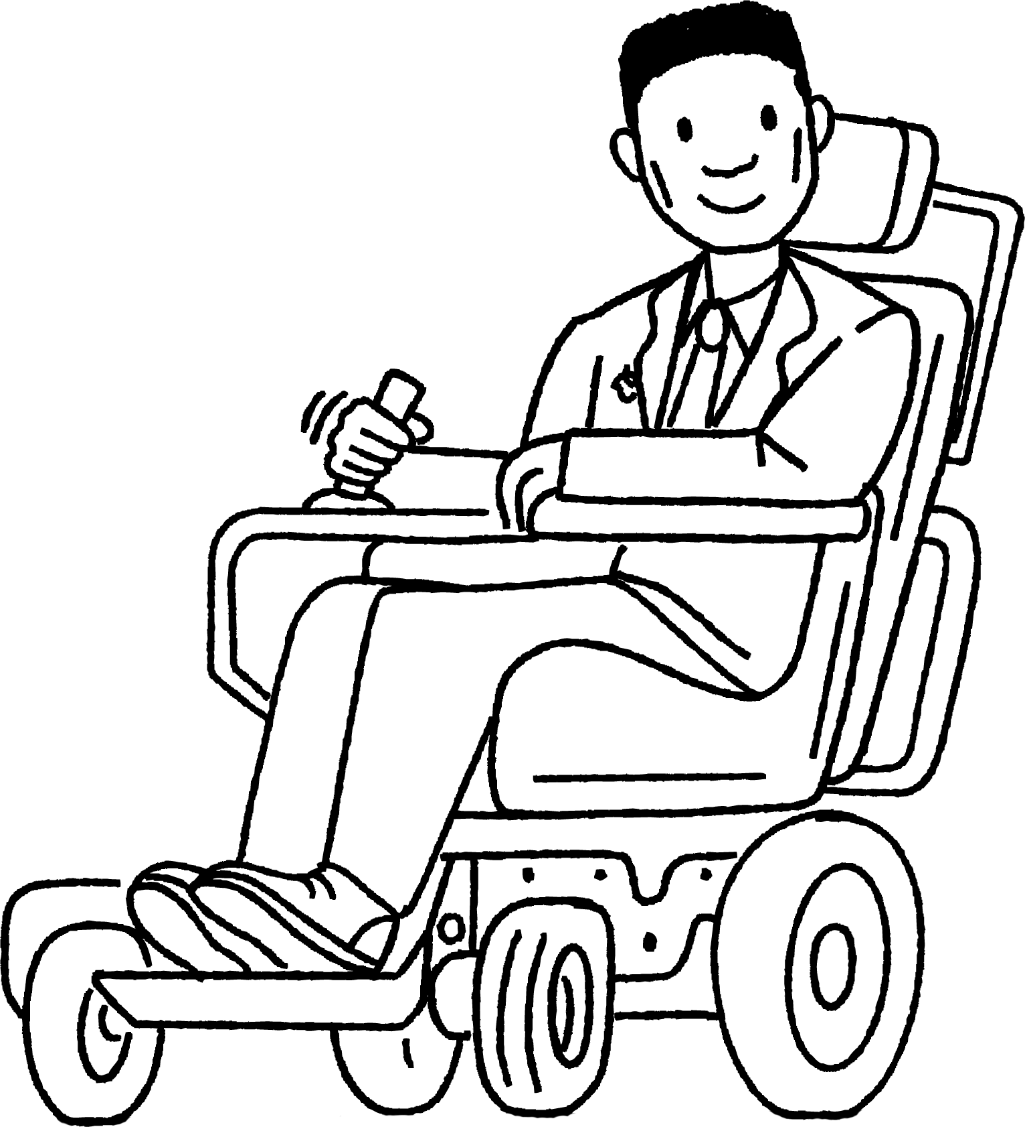
Error intervals (addition and multiplication)
Using error intervals in calculations allows us to work out largest and smallest values. This is important in real life as well as industries such as engineering, construction, medicine etc.
I am confused! I have run out of paint but I have measured everything correctly and read the instructions correctly.
Alex
Lucas
Let’s have a look.

Slide 13

Error intervals (addition and multiplication)
The paint tin says it covers 45 m² (rounded to the nearest integer).
Alex measured the wall to be 9 m by 5 m (rounded to the nearest integer).
5 m
Why have I run out of paint?
9 m

Slide 14

Error intervals (addition and multiplication)
The paint tin says it covers 45 m² (rounded to the nearest integer).
44.5 ≤ a < 45.5
This means the tin of paint would cover an area between 44.5 m² and 45.5 m² , including 44.5 and not including 45.5
The error interval for the area is 44.5 ≤ a < 45.5
Lucas
Alex

Slide 15
Error intervals (addition and multiplication)
Alex has rounded his measurements to the nearest integer. Work out the error interval for the width and length.
4.5 m ≤ w < 5.5 m
5 m
9 m
8.5 m ≤ l < 9.5 m

Slide 16
Error intervals (addition and multiplication)
Work out the error interval for the area, a, of the wall.
Smallest area: 4.5 x 8.5 = 38.25 m²
4.5 m ≤ w < 5.5 m
5 m
Largest area: 5.5 x 9.5 = 52.25 m²
9 m
Error interval of area: 38.25 m² ≤ a < 52.25 m²
8.5 m ≤ l < 9.5 m

Slide 17
Error intervals (addition and multiplication)
The paint tin says it covers 45 m² (rounded to the nearest integer).
44.5 ≤ a < 45.5
Alex measured the wall to be 9 m by 5 m (Rounded to the nearest integer)
5 m
38.25 ≤ a < 52.25
I see why I do not have enough paint!
9 m

Slide 18
Error intervals (addition and multiplication)
The paint tin says it covers 45 m² (rounded to the nearest integer).
This is the error interval for the area covered by the tin of paint.
44.5 ≤ a < 45.5
Alex measured the wall to be 9 m by 5 m (Rounded to the nearest integer)
5 m
38.25 ≤ a < 52.25
The possible area of the wall can be greater than 45.5 m² so this is the reason why the tin of paint did not cover the wall.
9 m

Slide 19
Error intervals (addition and multiplication)
1) Work out the error interval for the perimeter of these shapes:
a)
b)
c)
c
b
w
l
a
a = 5 cm (1 s.f.)
w = 2.3 cm (1 d.p.)
Square with lengths
3 cm (1 s.f.)
b = 12 cm (2 s.f.)
l = 7.9 cm (1 d.p.)
c = 13 cm (2 s.f.)

Slide 20
Error intervals (addition and multiplication)
2) Work out the error interval for the area of these shapes:
a)
b)
c
b
a
a = 5 cm (1 s.f.)
Square with lengths
4.3 cm (1 d.p.)
b = 12 cm (2 s.f.)
c = 13 cm (2 s.f.)

Slide 21
Error intervals (addition and multiplication)
3) Given the error interval of the area, can you work out the rounded lengths and the degree of accuracy?
Square with lengths
68.0625 cm² ≤ area < 69.7225 cm²

Slide 22
Error intervals (addition and multiplication)
1) Work out the error interval for the perimeter of these shapes:
a)
b)
c)
c
w
b
l
a
2.25 ≤ w < 2.35
4.5 ≤ a < 5.5
2.5 ≤ l < 3.5
7.85 ≤ l < 7.95
11.5 ≤ b < 12.5
2.5 × 4 ≤ p < 3.5 × 4
2(2.25+7.85) ≤ p < 2(2.35+7.95)
12.5 ≤ c < 13.5
10 ≤ p < 14
20.2 ≤ p < 20.6
28.5 ≤ p < 31.5

Slide 23
Error intervals (addition and multiplication)
2) Work out the error interval for the area of these shapes:
a)
b)
4.5 ≤ a < 5.5
c
b
11.5 ≤ b < 12.5
Lower area : 0.5 × 4.5 × 11.5
Upper area : 0.5 × 5.5 × 12.5
25.875 ≤ area < 34.375
a
4.25 ≤ l < 4.35
4.25² ≤ a < 4.35²
18.0625 ≤ a < 18.9225

Slide 24


Error intervals (addition and multiplication)
3) Given the error interval of the area, can you work out the rounded lengths and the degree of accuracy?
Square with lengths
8.3 cm (1 d.p)
≤ l <
8.25 ≤ l < 8.35
68.0625 cm² ≤ area < 69.7225 cm²

Slide 25
Using inequality notation for errors in calculations
Error intervals (addition and multiplication)
Error intervals in calculations

Slide 26
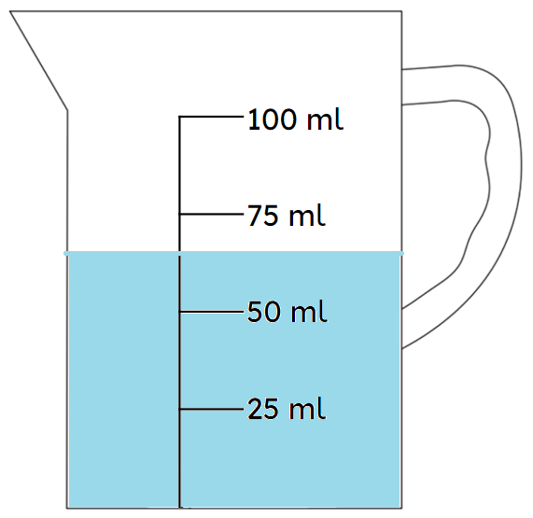

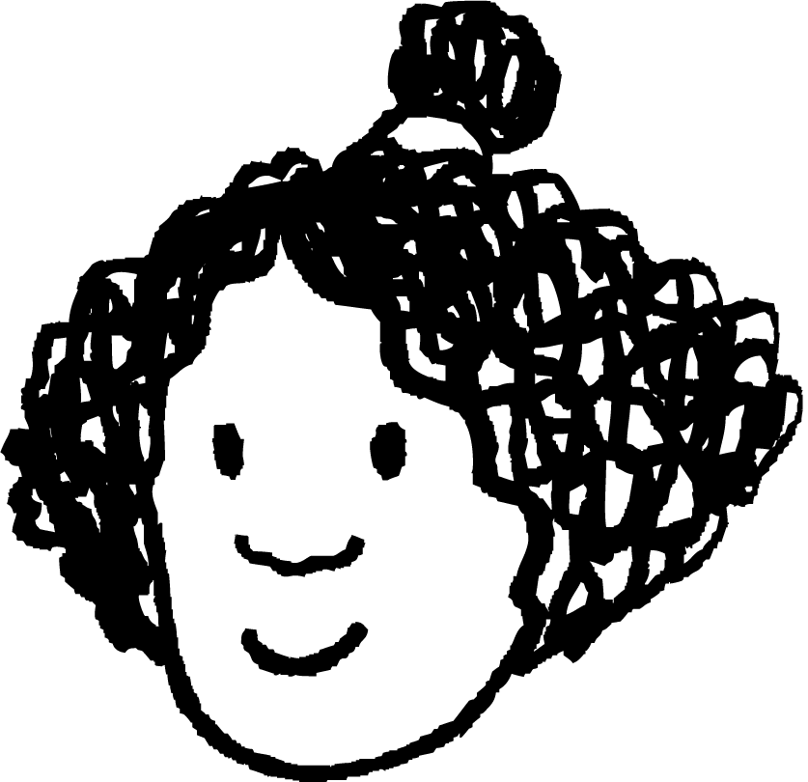

Error intervals in calculations
When using subtraction, it is important to know when the largest values and smallest values can be calculated.
For example, a jug was full to 100 ml (to the nearest integer). Laura drank 30 ml to the nearest ml.
The lowest amount of water left is 99.5 − 29.5
The lowest amount of water left is 100.5 − 30.5
Laura
Izzy
The lowest amount of water left is 99.5 − 30.5
Sofia
Who is correct?

Slide 27
Error intervals in calculations
The lowest amount of water left is 100.5 − 30.5
Izzy’s calculation would give 70 ml
Izzy
The lowest amount of water left is 99.5 − 29.5
Laura’s calculation would give 70 ml
The lowest amount of water left is 99.5 − 30.5
Laura
Sofia’s calculation would give 69 ml
Sofia

Slide 28
Error intervals in calculations
How did you work that out Sofia?
Good question! What is the error interval for the amount of water that was in the jug?
It is
29.5 ≤ w < 30.5
It is
99.5 ≤ w < 100.5
What is the error interval for the amount drank by Laura?
Sofia
Izzy
Water in jug originally
99.5 ≤ w < 100.5
Amount drank
29.5 ≤ d < 30.5

Slide 29
Error intervals in calculations
To work out the smallest remaining it is the
Smallest amount of water - Largest drank
- largest drink
Sofia
Izzy
Water in jug originally
99.5 ≤ w < 100.5
Amount drank
29.5 ≤ d < 30.5

Slide 30
Error intervals in calculations
How do you think we calculate the largest amount of water left in the jug?
Sofia
Izzy
Water in jug originally
99.5 ≤ w < 100.5
Amount drank
29.5 ≤ d < 30.5

Slide 31
Error intervals in calculations
To work out the largest remaining it is the
Largest amount of water - Largest drank
- smallest drink
Sofia
Izzy
Water in jug originally
99.5 ≤ w < 100.5
Amount drank
29.5 ≤ d < 30.5

Slide 32
Error intervals in calculations
So this means the error interval for the amount of water left in the jug is
Superb Izzy!
69 < j
69 < j < 71
Sofia
Izzy
Water in jug originally
99.5 ≤ w < 100.5
99.5 − 30.5 = 69
100.5 − 29.5 = 71
Amount drank
29.5 ≤ d < 30.5

Slide 33
Error intervals in calculations
The error interval of the amount of water left from a 100 ml (to the nearest integer) after Laura drinking 30 ml (to the nearest integer) is:
69 < j < 71
Summarising:
71 is the difference between the upper limit of w and lower limit of d
69 is the difference between the lower limit of w and upper limit of d
99.5 ≤ w < 100.5
29.5 ≤ d < 30.5

Slide 34
Error intervals in calculations
Work out the error interval for the remaining length of rope:
A rope was originally 3.2 m (1 d.p). A piece of 1.6 m (1 d.p) was cut from the rope. What is error interval for the remaining length?
Original length
3.15 ≤ l < 3.25
Upper limit remaining : 3.25 − 1.55 = 1.7
Lower limit remaining : 3.15 − 1.65 = 1.5
Cut length
1.55 ≤ c < 1.65
Remaining length
1.5 < c < 1.7

Slide 35

Error intervals in calculations
1) A rope was originally 5.3 cm (1 d.p.). A piece of 3.8 cm (1 d.p.) was cut from the rope. What is the error interval for the remaining length?
2) A coffee had 330 ml (the nearest integer) and Lucas drank 32 ml (2 s.f.). What is the error interval for the remaining coffee?

Slide 36
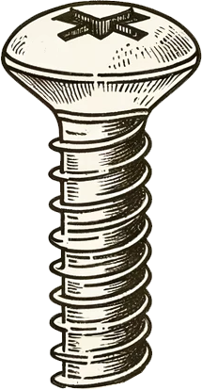


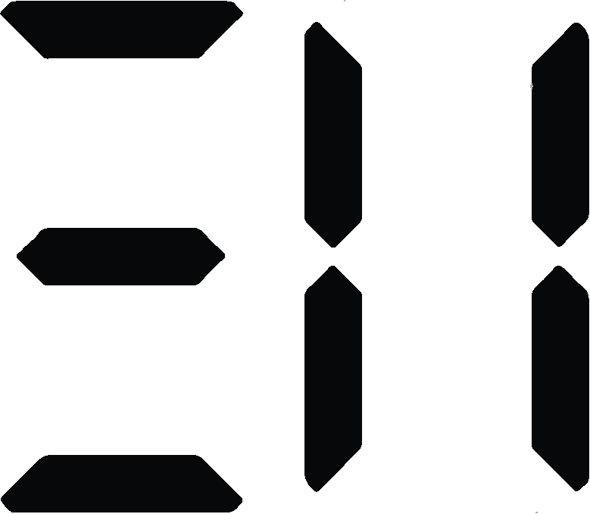
Error intervals in calculations
3) A screw has broken off from a wall.
Originally the screw was 4.6 mm (1 d.p.).
The broken off piece measures 3.4 mm (1 d.p.).
Work out the error interval length of the screw which is lodged in the wall.
4) A box of sweets and a chocolate weigh 43.26 g correct to 2 d.p.
If the chocolate alone weighs 21.14 g (2 d.p.), what is the error interval for the mass of the box of sweets?

Slide 37
Error intervals in calculations
1) A rope was originally 5.3 cm (1 d.p.). A piece of 3.8 cm (1 d.p.) was cut from the rope. What is the error interval for the remaining length?
Original length
5.25 ≤ l < 5.35
Upper limit remaining : 5.35 − 3.75 = 1.6
Lower limit remaining : 5.25 − 3.85 = 1.4
Cut length
3.75 ≤ c < 3.85
Remaining length
1.4 < remaining < 1.6

Slide 38
Error intervals in calculations
2) A coffee had 330 ml (the nearest integer) and Lucas drank 32 ml (2 s.f.). What is the error interval for the remaining coffee?
Original full coffee
329.5 ≤ c < 330.5
Upper limit remaining : 330.5 − 31.5 = 299
Lower limit remaining : 329.5 − 32.5 = 297
Amount drank
31.5 ≤ d < 32.5
Remaining coffee
297 < coffee < 299

Slide 39
Error intervals in calculations
3) A screw has broken off from a wall.
Originally the screw was 4.6 mm (1 d.p.).
The broken off piece measures 3.4 mm (1 d.p.).
Work out the error interval length of the screw which is lodged in the wall.
Original full screw
4.55 ≤ s < 4.65
Upper limit lodged in wall : 4.65 − 3.35 = 1.3
Lower limit lodged in wall : 4.55 − 3.45 = 1.1
Broken off
3.35 ≤ b < 3.45
Lodged in wall
1.1 < l < 1.3

Slide 40
Error intervals in calculations
4) A box of sweets and a chocolate weigh 43.26 g correct to 2 d.p.
If the chocolate alone weighs 21.14 g (2 d.p.), what is the error interval for the mass of the box of sweets?
Total mass
43.255 ≤ m < 43.265
Upper limit sweets : 43.265 − 21.135 = 22.13
Lower limit sweets : 43.255 − 21.145 = 22.11
Chocolate
21.135 ≤ c < 21.145
Mass of sweets in box
22.13 < s < 22.11

Slide 41
Using inequality notation for errors in calculations
The error intervals have a lower and upper limit.
a ≤ x < b
Where a represents the lower limit of the error interval and b represents the upper limit of the error interval.
It is important to know which limits from our error intervals to use in order to calculate the largest and smallest values.

Slide 42

© Oak National Academy 2024.
Produced in partnership with Mathematics in Education and Industry.
Licensed on the Open Government Licence v3.0, except where otherwise stated. See Oak terms and conditions.

